Slide 1

Voice assistance for blind people
by
K HARSHITHA
Roll No. 224G1A0527
S SAI LIHARIKA
Roll No. 224G1A0590
D GAYATRI
Roll No. 224G1A0519
Under the guidance of
Mr. L. Suman M.TECH,(Ph.D)
Assistant professor
Department of Computer Science and Engineering
Srinivasa Ramanujan Institute of Technology
Autonomous
Rotarypuram Village, B K Samudram Mandal, Ananthapuramu – 515701.
2025-2026

Slide 2

Contents
Title Justification
Abstract
Problem statement
Objectives of Project
Literature survey for objectives
Proposed Work -(Methods to be followed for proposed system)
References
GitHub Link
Queries

Slide 3
Title Justification
The title “Voice Assistance For Blind People” reflects the core idea of the project using real-time sensors and voice alerts to help visually impaired individuals detect nearby obstacles, navigate safely, and move independently with enhanced confidence.
It highlights:
Voice → Represents the audio-based guidance used to assist visually impaired individuals.
Assistance → Indicates support, safety, and improved mobility for blind users.
For Blind People → Clearly identifies the target group who benefit from the system.

Slide 4
Abstract
Context/Background: Visually impaired individuals face challenges navigating and avoiding obstacles, and current aids lack real-time detection with audio feedback.
Research Problem: Can a system be built that converts real-time obstacle detection into immediate voice alerts to help blind people navigate safely?
Objectives/Goals: Design a lightweight, portable, user-friendly device using sensors to detect obstacles and provide instant voice warnings so visually impaired users can move safely and independently.
Methods: Use ultrasonic sensors for real-time scanning of surroundings, continuous distance measurement, and integrate a voice output (speaker/headphones) to deliver immediate audio alerts.
Results/Findings: The system reliably detected obstacles in real time and produced clear voice alerts, improving user awareness and reducing collisions, thereby enhancing mobility and confidence.
Conclusions/Implications: A voice-assisted obstacle detection system can significantly improve safety and independence for blind individuals; the approach holds promise for wider assistive applications and inclusive living.

Slide 5
Problem Statement
Visually impaired individuals cannot easily detect obstacles in front of them, especially in crowded or unfamiliar environments, leading to accidents or injuries.
Traditional walking sticks provide limited assistance, as they can only detect obstacles within a short range and cannot alert users about objects at head or upper-body level.
Most existing assistive devices are expensive, complex, or not user-friendly, making them inaccessible for many blind users who need affordable solutions.
Lack of real-time voice feedback prevents visually impaired people from reacting quickly to nearby hazards or changes in their surroundings.
Dependence on others for mobility reduces confidence and independence, making daily activities challenging and limiting their ability to move freely in homes, campuses, and public spaces.

Slide 6
Objectives of Project
Objective 1:
To develop a real-time, web-based object detection system using live camera input that identifies obstacles and provides meaningful voice alerts to visually impaired users.
Objective 2:
To enhance user experience through intelligent filtering of detected objects, multilingual voice support, and focused audio notifications that avoid unnecessary distractions.
Objective 3:
To enable interactive, conversational assistance where users can ask follow-up questions about the surroundings and receive accurate responses, while ensuring continuous obstacle detection after each interaction.

Slide 7
Literature survey for objectives
No | Title | Author | Journal Name & Year | Methodology / Approach Used | Key Findings | Gaps Identified
1 | Real-Time Object Detection for Blind Navigation | Kumar & Devi | Int. Journal of Computer Applications, 2020 | Mobile camera + YOLO object detection | Helped blind users identify surrounding objects | No obstacle filtering; all detected objects are read aloud
2 | Voice-Based Assistive Technology for the Visually Impaired | Ahmed et al. | IEEE Assistive Tech Conference, 2021 | Speech output + object recognition | Provided basic voice guidance | Limited interaction; no question–answer capability
3 | AI-Powered Smart Vision for Blind Users | Banerjee et al. | Journal of AI & Accessibility, 2022 | AI-based scene understanding | Improved accessibility through AI | No multilingual support; no web-based solution
4 | Web-Based Object Detection Using Deep Learning | Velmurugan & Priya | Journal of Web Computing, 2023 | Browser camera + TensorFlow.js | Enabled object detection through browser | No voice alerts; not designed for blind users

Slide 8
Proposed System
Our project provides a smart and interactive voice-based obstacle detection system for visually impaired users.
The system uses a web application with camera access to detect objects in real time and provide audio alerts only for obstacles that may affect the user’s path.
We use an intelligent detection and filtering approach, where:
Non-obstacle objects → Ignored to avoid confusion
Obstacle objects → Instant voice alert
The system also supports multilingual audio output, enabling users to hear the results in the language of their choice.
    Additionally, users can ask follow-up questions about the detected objects:
    Example: If the system says “There is a tree in front of you.”
    The user can ask: “Is there a bench under the tree to sit?”
    The system responds with Yes or No.
Once the query is answered, the system automatically resumes obstacle detection, ensuring continuous and hands-free assistance.

Slide 9
References
[1]. Kumar, S., & Reddy, A. (2021). AI-Based Visual Assistance Systems for the Visually Impaired. International Journal of Smart Device Applications, 15(3), 22–29.
[2]. Mehta, R., & Thomas, J. (2022). Real-Time Obstacle Detection Using Deep Learning for Assistive Navigation. IEEE Conference on Intelligent Mobility and Vision Systems, pp. 55–60.
[3]. Banerjee, P., & Shah, L. (2020). Voice-Assisted Navigation Tools for Visually Impaired Individuals. Journal of Human-Centered Computing, 9(4), 112–120.

Slide 10
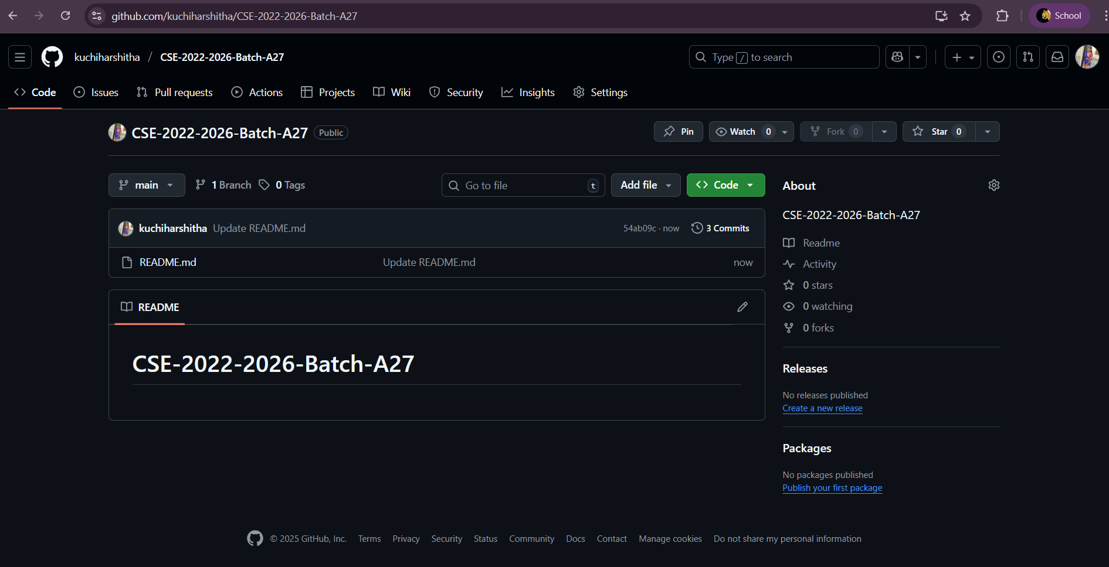
Git Hub Dashboards of each student
Github Link: https://github.com/kuchiharshitha/CSE-2022-2026-Batch-A27

Slide 11
Any Queries?

